Slide 1
HKBK College of Engineering Department of Computer Science and Engineering Self-Evolving AI System for Smart Ports.
Ist Review
Presented by Guided by
1.NAMRATHA (1HK23CS107)
2.POOJA SURVE (1HK23CS116)
3.POOJA V (1HK23CS117)
4.PRAVEEN C (1HK23CS121)
Date:
Under the Guidance of
Prof.Shimja KJ
Assistant Professor
Dept. of CSE, HKBKCE
09/18/2025

Slide 2
Abstract
AI system that learns and improves port workflows automatically
Uses meta-learning and digital twins for safe testing
Continuously optimizes port operations without manual changes

Slide 3
Introduction
Ports = backbone of global trade, handling massive cargo volumes daily
Problems: congestion, resource mismanagement, equipment failures, and unpredictable delays.
Traditional methods rely on human oversight and past data → lack adaptability
AI + simulation can provide predictive insights, but need continuous evolution for future-ready ports

Slide 4
Literature Survey – Limitations
S.No. | Title of the Paper | Algorithm Used | Parameter | Efficiency
1. | Smart Ports: Utilizing AI-Driven Predictive Analytics and Simulation for Operational Excellence (IEEE 2024)Balika J chelliah,A.Senthilselvi,Sarghi kaur Gahra,S.Senthilpandi Department of CSE,chennai,India | Random Forest, LSTM | Turnaround time, throughput | ↑ Efficiency, ↓ delays
2. | Truck Routing (Adi et al., 2020) | Deep RL | Routing, fuel use | Faster routes, cost saving
3. | Maritime Anomaly Detection (2022) | SVM | Ship trajectory | Better hazard detection
4. | Shipping Ops Optimization (2021) | Deep Learning | Equipment failures | Less downtime
5. | E-Navigation (2020) | Real-time Data (AIS/ECDIS) | Route planning Safer | less delay
6. | Proposed Work (Novel) | Meta-Learning + Digital Twin | Workflow evolution | Self-adaptive system

Slide 5
Existing System – Problem Statement
Current smart port systems predict issues but do not evolve with changing data
They are reactive, not proactive
-Challenges identified:
Lack of adaptability to sudden cargo surges or equipment breakdown
Workflow optimization limited to pre-defined rules
High human dependency for updates and decisions.

Slide 6
Objectives
Develop a meta-learning AI model capable of self-improvement.
Design a Digital Twin that mirrors real-world port operations virtually.
Implement automated A/B testing to compare workflow changes in simulation
Achieve autonomous workflow evolution → better efficiency, lower costs, minimal delays.

Slide 7
Proposed System
Self-Evolving AI Core: Learns how to improve its own optimization strategies
Digital Twin Simulation: Tests proposed workflows virtually without real-world risks
Automated A/B Testing: Compares multiple workflow variations to select best outcome
Feedback Loop: Real-world results feed back into AI for continuous evolution
Key Focus: Cargo handling, berth allocation, and resource utilization.

Slide 8
Proposed Algorithm Used
Meta-Learning with Predictive Analytics:
Collect operational data (ships, cargo, weather, equipment)
Apply predictive models (LSTM, RF, SVM) for forecasting.
Meta-learning AI generates workflow variations.
Test workflows in Digital Twin simulation.
Run A/B testing → choose best performing workflow.
Deploy in real-world → feedback loop updates AI.

Slide 9
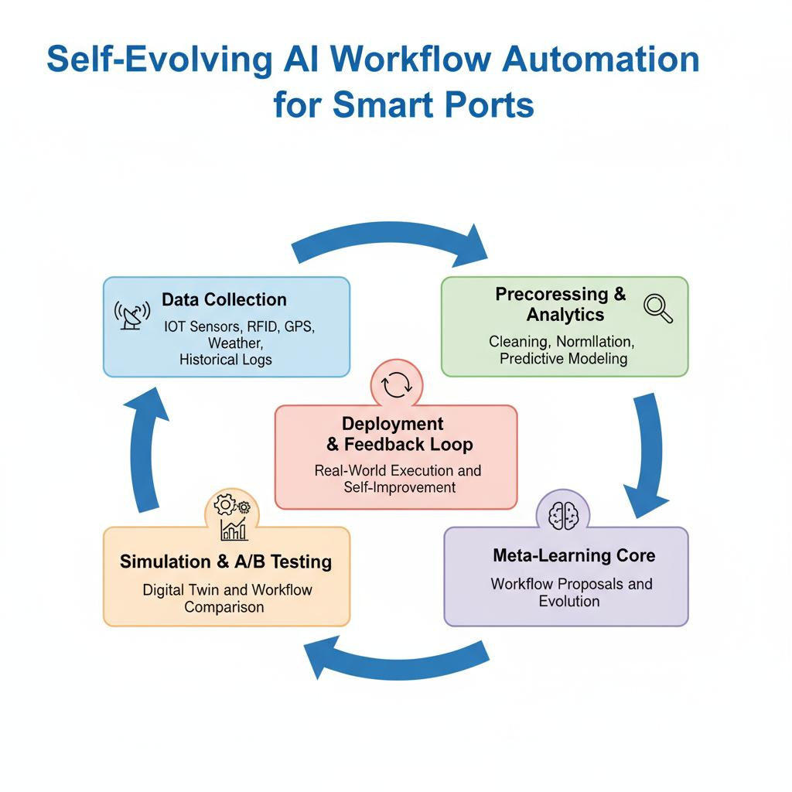
Proposed System – Functional architectural Diagram

Slide 10
Project Specification(Hardware/Software)
Hardware Requirements:
PC/Laptop, 8GB+ RAM, i5/i7 processor, IoT data simulators.
Software Requirements:
Python (core language)
PyTorch/TensorFlow (AI/Meta-learning models)
SimPy / AnyLogic (Simulation modeling)
Kafka /MQTT (Real-time data streaming)
Dash/Plotly (Visualization dashboard)
Docker (Deployment & containerization)

Slide 11
Expected Outcomes
Reduced vessel turnaround & cargo delays.
Improved resource utilization.
Adaptive, evolving AI system.
Reduced need for manual intervention.

Slide 12
REFERENCES
IEEE Base Paper: Smart Ports Utilizing AI-Driven Predictive Analytics and Simulation for Operational Excellence (2024) Balika J chelliah,A.Senthilselvi,Sarghi kaur Gahra,S.Senthilpandi Department of CSE,chennai,India.
Supporting works on Meta-Learning AI and Digital Twin applications.
Additional AI/IoT research papers on port automation.

Slide 13
Queries

Slide 14
THANK YOU

